Slide 1
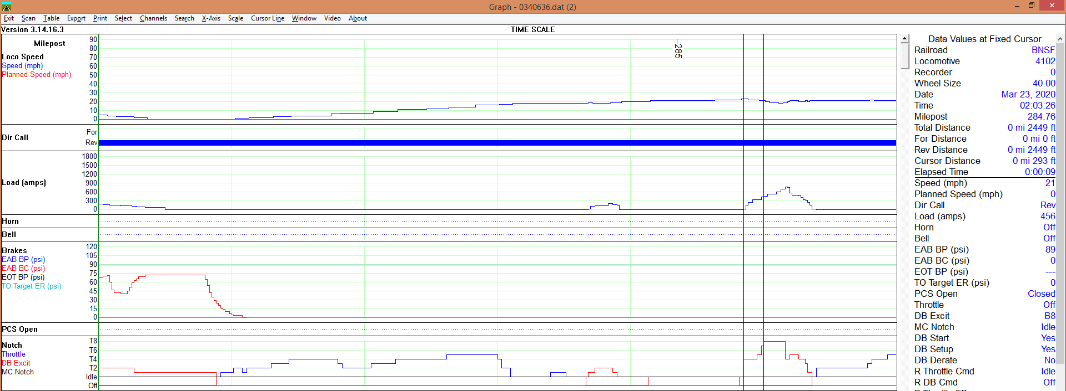
Derailment No. 1 – Cherokee Sub March 23, 2020
H-MEMTUL3-21A
93 Cars – 56 lds 37 mty’s 8716T - 6164F – 4x0 (non-DP)
Train handling
23 mph
Set-up to DB8 in 9 seconds with run-in signature in speed trace

Slide 2
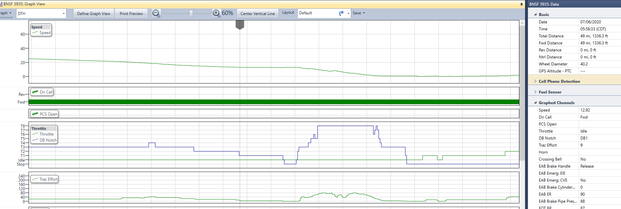
Derailment No. 2 – Gallup Sub July 6, 2020
S-KCKSCO1-04
143 Cars – 119 lds 24 mty’s 14,497T – 11,393F - 4x2x0 DP
Train handling
12 mph
Set-up to DB8 in 7 seconds with run-in signature in speed trace

Slide 3
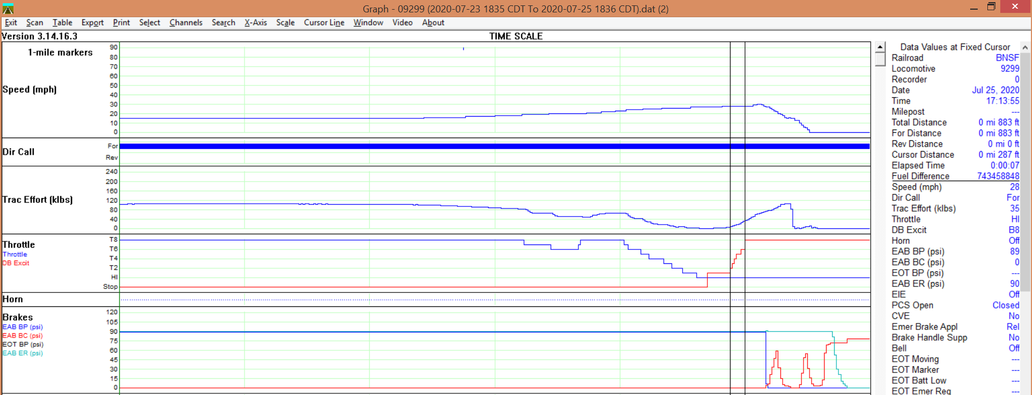
Derailment No. 3 – Phoenix Sub July 25, 2020
H-BELPHX1-24
86 Cars – 83 lds 3 mty’s 10,740T - 5147F - 3x1 DP
Train handling
28 mph
DB 1 to 8 in 7 seconds with run-in signature in speed trace

Slide 4
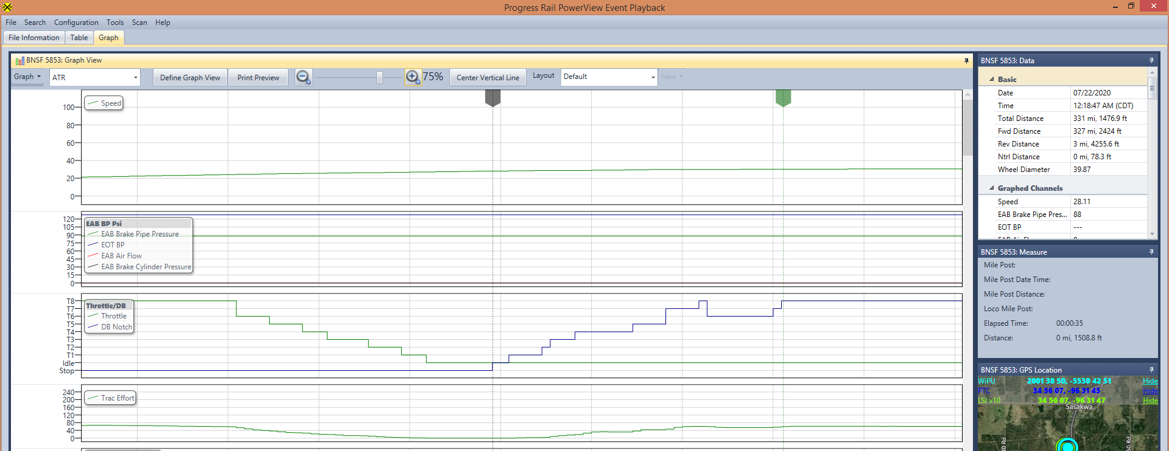
Example of Proper Dynamic Brake Handling
Gradual increase in DB over a period of 35 seconds ~ 1500 feet

